Slide 1
JAVA Project STONE PAPER scissors

Slide 2
Group Members
Parv Garg (17STUCHH010362)
Sanjana Jain(17STUCHH010280)
MD Nizam(17STUCHH010125)
Priyank Hathiyani (17STUCHH010197)
All students are from Section 2 Dr. Balamurali R

Slide 3
Project Abstract
It's a fun game which everyone might have played in there childhood. But now in this technical world people can play this game on there computer's.
1.Two people can play the game at once.
2.They will have to enter there names and click on the play button.
3.Then computer will choose itself among the stone paper and scissor.
4. One can choose the number of times to repeat
5. Member who wins the most number of times wins!

Slide 4
Hardware Requirement
Minimum Windows 95 software
IBM-compatible 486 system
Hard Drive and Minimum of 8 MB memory
Mouse, keyboard and sound card, if required.
Software Requirement
Operating System
Java SDK or JRE 1.6 or higher
Java Servlet Container (Free Servlet Container available)
Supported Database and library that supports the database connection with Java.

Slide 5
Source Code
//IMPORT SCANNER FUNCTION
import java.util.Scanner;
public class project{
public static void main(String args[])
{
start();
//Creating an object of Scanner class
Scanner userInput= new Scanner(System.in);
//LOOP IS REQUIRED TO RESTART THE PROGRAM
while(true)
{
System.out.print("Press 1 for one more time:\n");
int d=userInput.nextInt();
if(d==1)
{
start();
}
else{
return;
}
}
}
public static void start()
{
Scanner userInput= new Scanner(System.in);
System.out.println("\nWelcome to Stone Paper Scissors\n");
System.out.print("Enter the Name of Player 1:");
String player1= userInput.nextLine();
System.out.print("Enter the Name of Player 2:");
String player2= userInput.nextLine();
System.out.print("Enter the number of times you guys want to repeat:");
int n= userInput.nextInt();
int i=1;
int num1=0,num2=0,num3=0;
//System.out.println(ran());
for (i=1;i<=n;i++){
int rand1=ran();
int rand2=ran();
int winner= win(rand1,rand2);
if (winner ==1){
num1+=1;
}
else if (winner==2){
num2+=1;
}
else
{
num3+=1;
}
display(i,winner,player1,player2);
promptEnterKey();
}
System.out.println("\n \nNumber of Repeat:\t"+n+"\n"+"Number of times "+player1+" wins:\t"+num1
+"\n"+"Number of times "+player2+" wins:\t"+num2+"\n"+"Number of Draws:\t"+num3+"\n\n");
if(num1>num2)
{
System.out.println(player1+" is the Winner");
}
else if(num2>num1)
{
System.out.println(player2+" is the Winner");
}
else{
System.out.println("It is a Tie!");
}
}
//Random function
public static int ran(){
int x = (int)(Math.random()*((3-1)+1))+1;
return x;
}
//winner function
public static int win(int x,int y){
//1=Stone, 2=Paper, 3=Scissors
if (x==1 && y==2)
{
return 2;
}
else if (x==1 && y==1)
{
return 0;
}
else if (x==1 && y==3)
{
return 1;
}
//x=2
else if (x==2 && y==1)
{
return 1;
}
else if (x==2 && y==2)
{
return 0;
}
else if (x==2 && y==3)
{
return 2;
}
//x=3
else if (x==3 && y==1)
{
return 2;
}
else if (x==3 && y==2)
{
return 1;
}
else if (x==3 && y==3)
{
return 0;
}
else
{
return 4;
}
}
//Display function
public static void display(int n,int x, String a,String b)
{
System.out.println();
if (x==1)
{
System.out.print("WINNER OF "+n+" is:\t");
System.out.println(a);
}
else if (x==2)
{
System.out.print("WINNER OF "+n+" is:\t");
System.out.println(b);
}
else if (x==4)
{
System.out.println("OOPS ERROR!");
}
else{
System.out.println("WINNER OF "+n+" is:\tDRAW!");
}
}
public static void promptEnterKey(){
System.out.println("Press \"ENTER\" to continue...");
Scanner scanner = new Scanner(System.in);
scanner.nextLine();
}
}

Slide 6
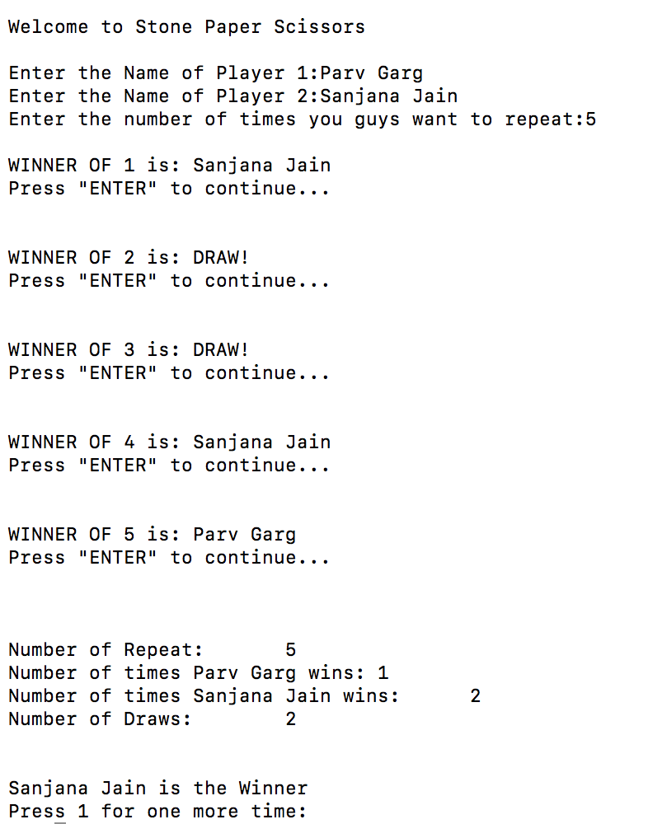
Output

Slide 7
Thank You The End

